Slide 1
The Inventory Application

Slide 2
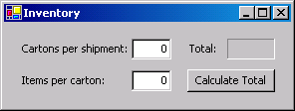
Constructing the Inventory Application
.
Label
TextBoxes
Button

Slide 3
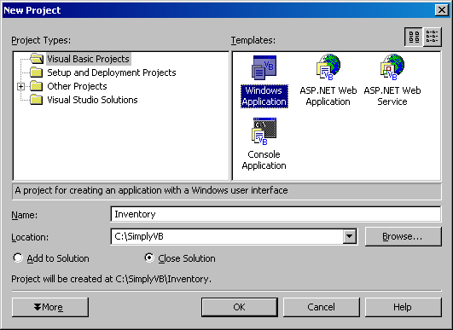
Constructing the Inventory Application
Project Types: pane with Visual Basic Projects folder selected (your folder list might differ)
Templates: pane with Windows Application selected
Name: TextBox
Location: TextBox
Browse… Button

Slide 4
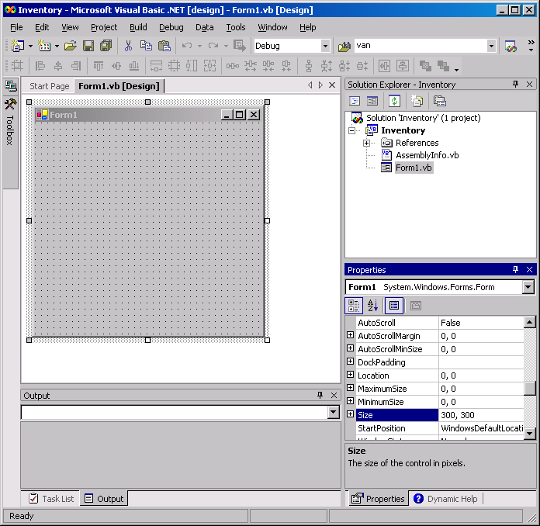
Constructing the Inventory Application
Form title bar (for Form1)
.
Form file name (Form1.vb)
Form

Slide 5
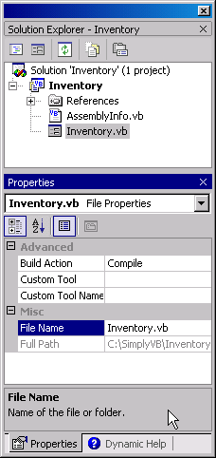
Change Form file name
Form’s file name after property change
2
Type new Form file name here
1
File Name property

Slide 6
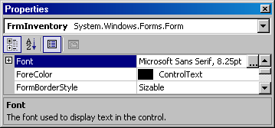
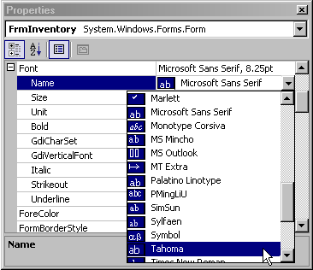
Name Propery “Font”
Click plus box to display Font properties
1
Click down arrow to display drop-down list
Name property
Select Tahoma from drop-down list
Notes:
Appearance - font

Slide 7
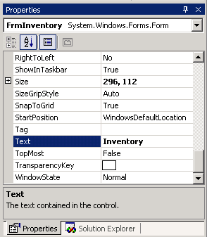
Text Property to form
Setting the Text property of a Form.
New value for Text property
Text property

Slide 8
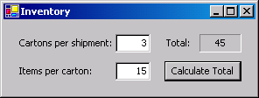
Labels
Adding labels to the Inventory Application
Descriptive Labels
Output Label (recessed appearance)
Labels used in the Inventory application.
Types of Label
Descriptive Labels
Output Labels
Notes:
recessed appearance: fixed3D
Autosize:false

Slide 9
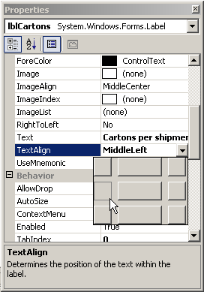
TextAlign Property
Changing the TextAlign property of a Label.
Value of TextAlign property (MiddleLeft)
TextAlign property
Down arrow
MiddleLeft TextAlign property value
Window displayed when down arrow is clicked

Slide 10

Process of Inventory Application
Result of calculation

Slide 11
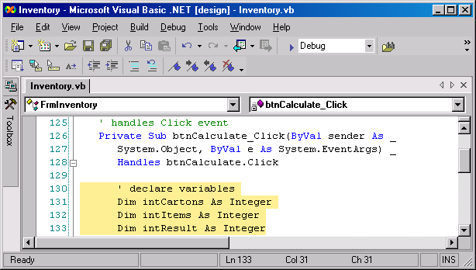
Variable Declaration
Declaring variables in event handler btnCalculate_Click.
Click event handler
Variable declarations

Slide 12
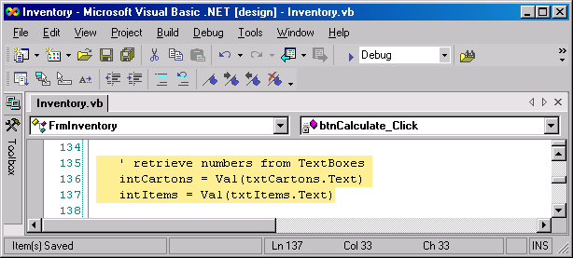
Retrieving Number
Retrieving numerical input from TextBoxes.

Slide 13
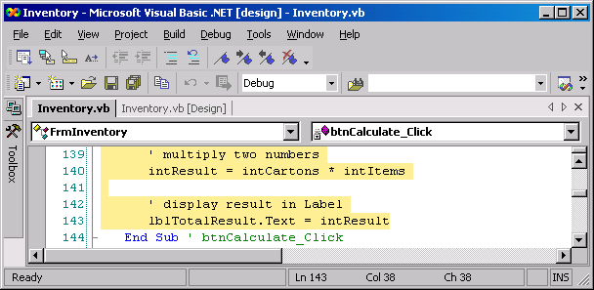
Multiplication Process
Multiplication, using variables in btnCalculate_Click.

Slide 14
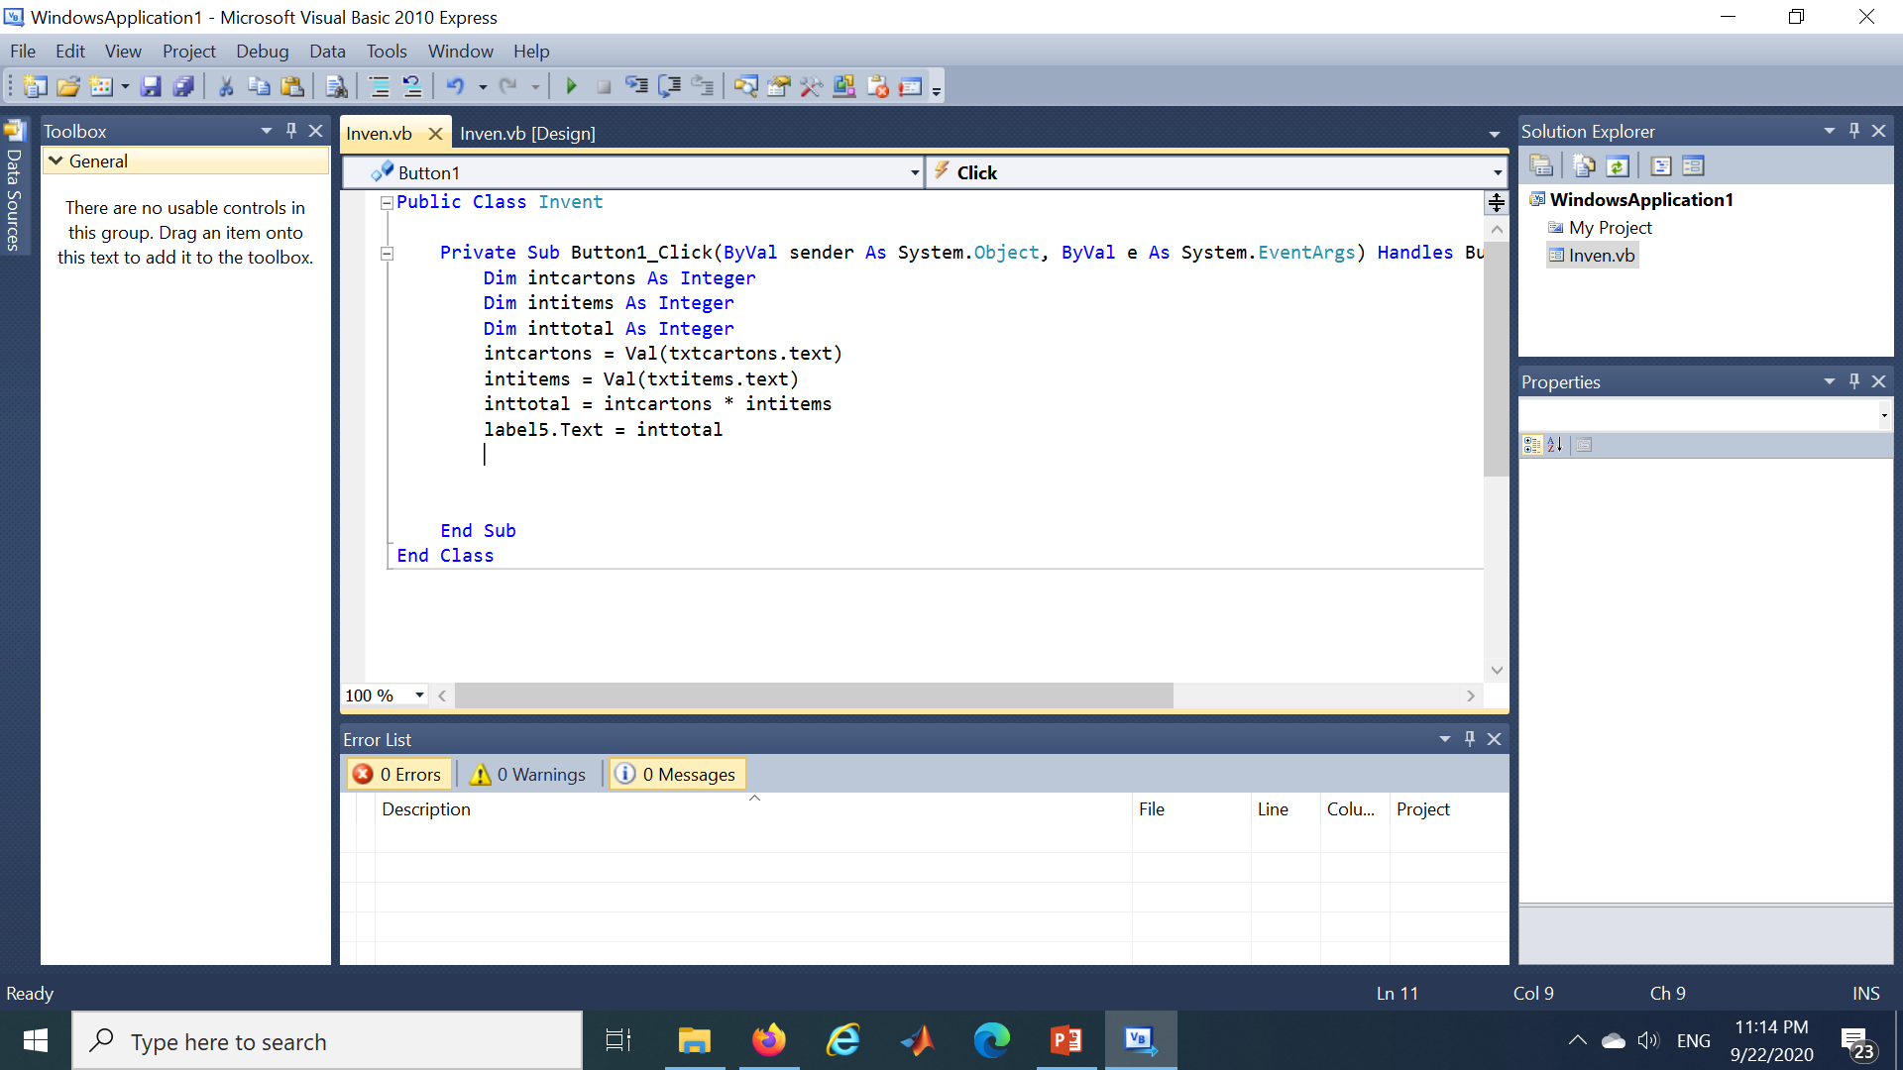

Slide 15
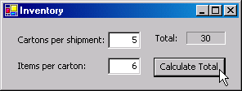
Constructing the Inventory Application
Displaying the multiplication result using variables.
Result of calculation
Running the application
Enter data
Click the Calculate Total Button
Notice the result

Slide 16
Constructing the Inventory Application
Memory locations after values for variables intCartons and intItems have been input.
intCartons
12
intItems
10
Visualizing data
The value of each variable is stored in a separate memory location

Slide 17
Memory Location
Memory locations after a multiplication operation.
intCartons
12
intItems
10
intResult
120
Using the variable’s data
Nondestructive when value is read from memory

Slide 18
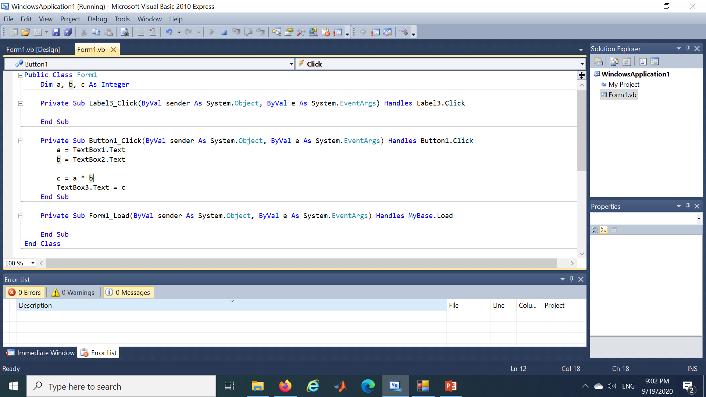
Notes:
Console.Write("Please insert first number ")
Dim m As Integer = Console.ReadLine()
Console.Write("Please insert second number ")
Dim n As Integer = Console.ReadLine()
Dim sum As Integer = m * n
Console.Write("The multiplication is {0}", sum)
Console.ReadLine()

